Slide 1
Notes:
[Introduce yourself]

Slide 2
Notes:
For the last twenty years, AAUW has been a national leader in documenting and bringing attention to the issue of sexual harassment in education. The AAUW reports Hostile Hallways: The AAUW Survey on Sexual Harassment in America’s Schools (1993) and Hostile Hallways: Bullying, Teasing, and Sexual Harassment in Schools (2001) spurred national debate on the prevalence of sexual harassment at school and its negative effect on students.
Today I am proud to share with you the findings from our latest survey and our research on the topic ― in the report Crossing the Line: Sexual Harassment at School.

Slide 3
This report was made possible by the generous
contributions of AAUW members and donors to
The Eleanor Roosevelt Fund
The Legal Advocacy Fund
and
The Mooneen Lecce Giving Circle
Notes:
This report was made possible by generous contributions from AAUW members and donors to the Eleanor Roosevelt Fund, the Legal Advocacy Fund, and the Mooneen Lecce Giving Circle.
The Mooneen Lecce Giving Circle honors the legacy of Mooneen Lecce, whose passion for the mission of AAUW continues to inspire volunteerism and charitable giving dedicated to improving the lives of women and girls.
We thank all of the members and donors who contributed to this report.

Slide 4
THE SURVEY
1,965 students in grades 7–12 participated in a nationally representative survey sample during
May and June 2011.
They shared their experiences and thoughts
about sexual harassment during the 2010–11 school year.
Notes:
Sexual harassment has long been an unfortunate part of the climate in middle and high schools in the United States. Often considered a kind of bullying, sexual harassment by definition involves sex and gender and therefore warrants separate attention.
Based on a nationally representative survey of 1,965 students in grades 7–12 designed and commissioned by AAUW and conducted by Knowledge Networks in May and June 2011, Crossing the Line: Sexual Harassment at School provides fresh evidence about students’ experiences with sexual harassment, including being harassed, harassing someone else, or witnessing harassment.
Focusing on the 2010–11 school year, the survey asked students to share their reactions to their experience with sexual harassment and its effect on them. It also asked them about their ideas for what schools can do to respond to and prevent sexual harassment.

Slide 5
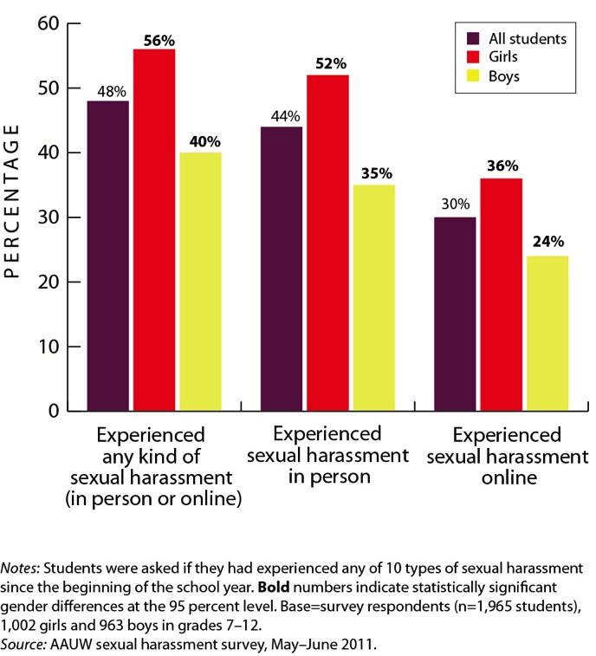
Figure 1. Students Who Experienced Sexual Harassment during the 2010–11 School Year, by Gender
Notes:
This chart shows us the prevalence of sexual harassment during one school year. In this chart, the purple bar refers to all students, the red bar refers to girls, and the yellow bar refers to boys. As we can see, many students experienced harassment both in person and online.
The chart shows us that about 30 percent of students were sexually harassed online and 44 percent were harassed in person. Looking at students who experienced either form of harassment, we find that nearly 1 in 2 students (48 percent) were sexually harassed during the 2010–11 school year. A significant difference exists between girls and boys, with 56 percent of girls and 40 percent of boys reporting experiencing some of form of harassment during the 2010–11 school year.

Slide 6
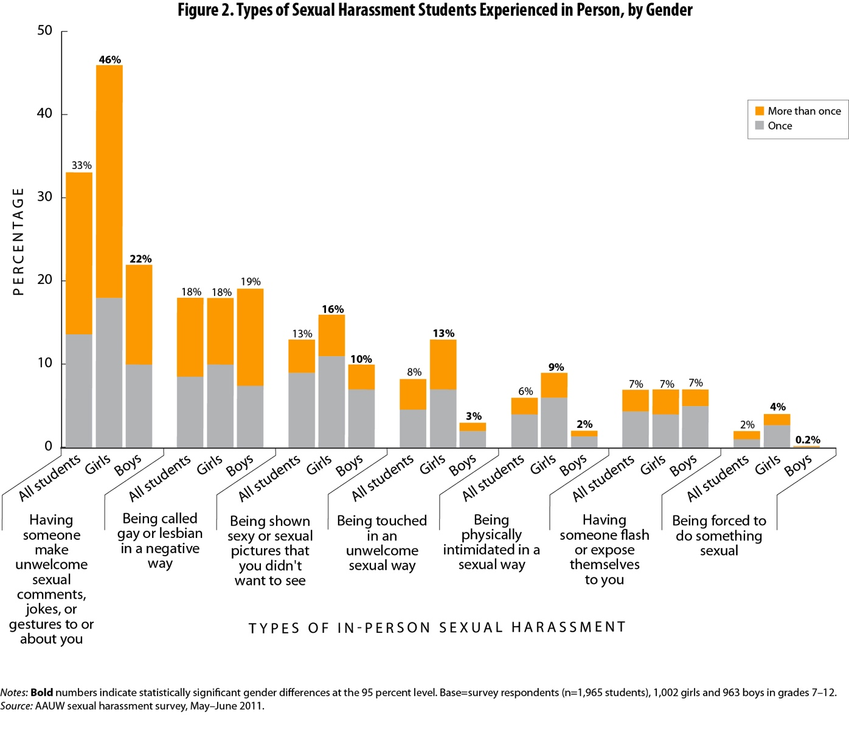
Figure 2. Types of Sexual Harassment Students Experienced in Person, by Gender
Notes:
Figure 2 shows us the types of harassment that students experienced. The grey portion of the bars represents students who said that they had experienced this type of harassment once, and the orange portion of the bars shows students who said that they had experienced this type of harassment more than once in school year 2010–11.
Unwelcome sexual comments, jokes, and gestures were the most common type of sexual harassment, and one-third of students (33 percent) encountered them at least once in school year 2010–11. Almost one-fifth of students (18 percent) were called gay or a lesbian in a negative way, and 13 percent said that they had been shown sexy or sexual images that they didn’t want to see.
Girls were more likely than boys to encounter most forms of sexual harassment. Girls were much more likely to experience unwanted sexual jokes, comments, or gestures (46 percent versus 22 percent). Girls and boys were about equally likely to be called gay or lesbian in a negative way (18 percent of students). Girls were more likely to say that they were shown sexy or sexual pictures that they did not want to see (16 percent of girls versus 10 percent of boys) and that they had been touched in an unwelcome sexual way (13 percent of girls versus 3 percent of boys). Girls were also more likely to say that they had been physically intimidated in a sexual way (9 percent of girls versus 2 percent of boys) or were forced to do something sexual (4 percent of girls versus less than 1 percent of boys). Girls (7 percent) and boys (7 percent) were equally likely to say that someone flashed or exposed him- or herself to them.

Slide 7
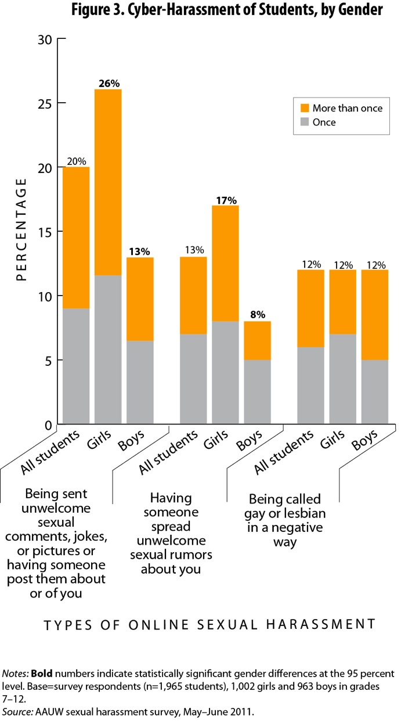
Figure 3. Cyber-Harassment of Students, by Gender
Notes:
This chart shows the prevalence of cyber-harassment. Like the previous chart, it also shows the number of students who experienced these forms of harassment once versus more than once.
Overall, cyber-harassment was less prevalent than in-person sexual harassment.
Still, more than one-third of girls (36 percent) and nearly one-quarter of boys (24 percent) experienced some type of harassment through text messages, e-mail, Facebook, or other electronic means.
Students could select more than one type of cyber-harassment, so the columns do not add up to 100.

Slide 8
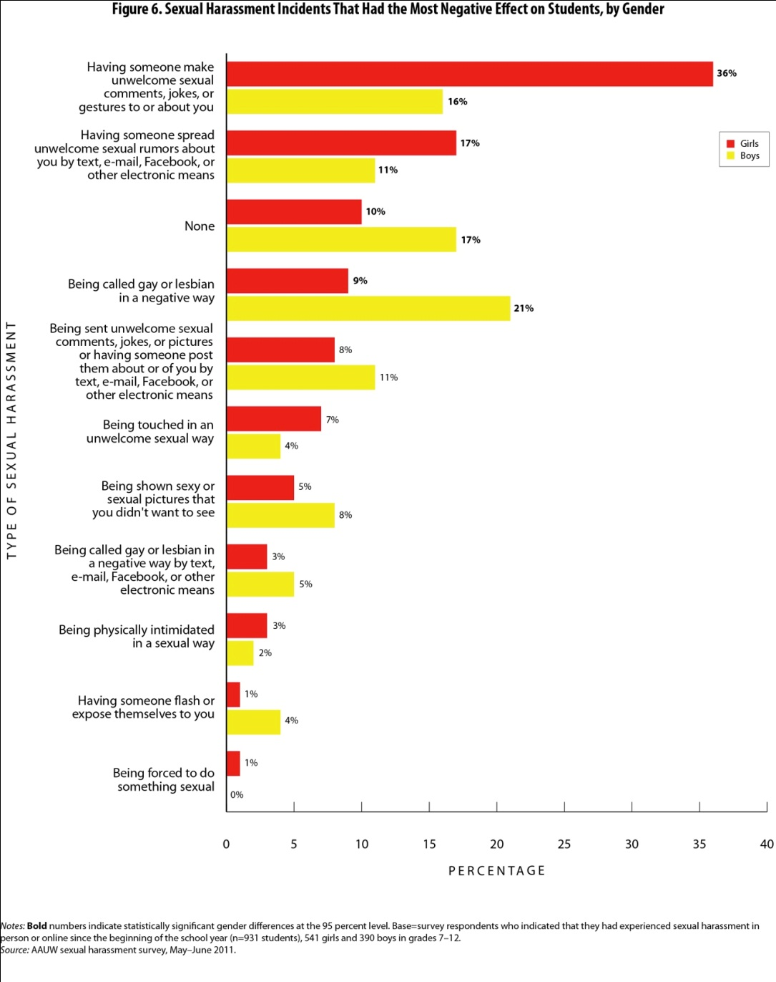
Figure 6. Sexual Harassment Incidents That Had the Most Negative Effect on Students, by Gender
Notes:
The 48 percent of students who reported sexual harassment in school year 2010–11 were asked which of their harassment experiences had the most negative effect on them.
From the graph you can see several gender differences in their responses.
Boys appear to be less affected than girls by sexual harassment. Seventeen percent of boys who had been sexually harassed selected “none” when indicating what form of sexual harassment had the most negative effect on them. In comparison, only 10 percent of sexually harassed girls said that none of their experiences with sexual harassment had a negative effect on them.
Girls were more likely than boys to identify unwelcome sexual comments, jokes, or gestures as having had the most negative effect on them (36 percent versus 16 percent). In part, this is because more girls than boys faced that type of sexual harassment. Having sexual rumors spread electronically about them had the second most negative impact on girls (17 percent versus 11 percent for boys), and that behavior was the fourth most common form of sexual harassment experienced by girls.
Boys were most likely to cite being called gay in a negative way in person as their most negative experience of sexual harassment. Girls and boys were equally likely to experience this type of sexual harassment (18 percent of students surveyed), but 21 percent of boys and only 9 percent of girls identified being called gay or lesbian as their worst experience of sexual harassment.

Slide 9
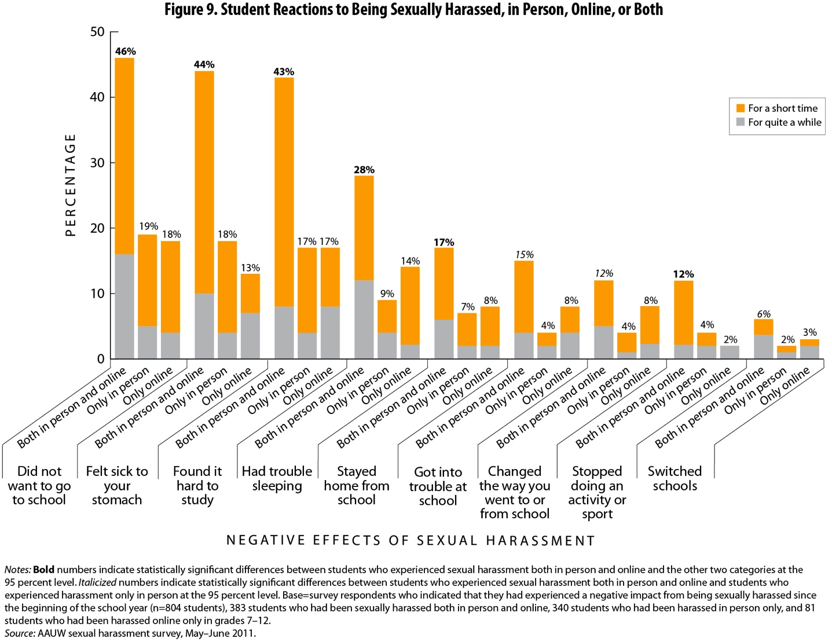
Figure 9. Student Reactions to Being Sexually Harassed, in Person, Online, or Both
Notes:
From the survey, it was clear that students who faced sexual harassment both online and in person were much more likely than those who faced it only online or only in person to say that it affected them. For example, 46 percent of students who had experienced sexual harassment both online and in person said that they did not want to go to school as a result of the sexual harassment, compared with 19 percent who were sexually harassed only in person and 18 percent who were sexually harassed only online. Of students who were sexually harassed both online and in person, 43 percent found it hard to study, compared with 17 percent of those who had been sexually harassed only in person or only online.
This finding suggests that parents and educators should keep an eye out for students who face sexual harassment through multiple avenues, because they are particularly vulnerable to having the harassment affect their ability to learn.

Slide 10
STUDENT VOICES
“I was sent a website to look up and I did and it was to a porn site. It was very upsetting to me.”
After being called a whore by “almost everyone” at her school and being sexually harassed both online and in person, an 8th-grade girl said she “looked into switching schools.”
“Everyone was saying I was gay, and I felt the need to have to run away and hide.”
“An 8th-grade guy passed by me and said, really softly, ‘What’s up, sexy?’ and then kept on walking. It really creeped me out.”
Notes:
Several students who took AAUW’s survey shared their feelings about the sexual harassment they faced.
“I was sent a website to look up and I did and it was to a porn site. It was very upsetting to me.”
“Everyone was saying I was gay, and I felt the need to have to run away and hide.”
After being the target of sexual rumors, a student said she “tried to ignore it” but then “thought of suicide.”
“An 8th-grade guy passed by me and said, really softly, ‘What’s up, sexy?’ and then kept on walking. It really creeped me out.”
Each of us can imagine how we might respond to these incidents, and we can probably imagine how our reactions might change in different circumstances.

Slide 11
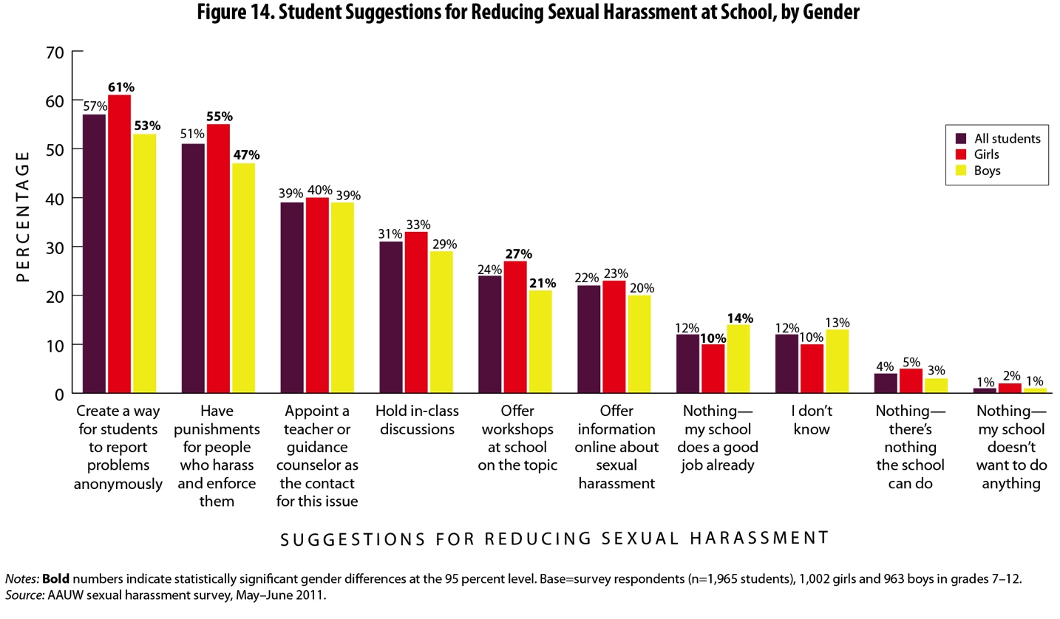
Figure 14. Student Suggestions for Reducing Sexual Harassment at School, by Gender
Notes:
AAUW’s survey clearly shows that sexual harassment continues to be a common problem in middle and high schools, affecting the educational experience of millions of children.
Fortunately, there are many ways to address and prevent sexual harassment, starting with the recommendations students themselves offered in the survey.
Creating a way for students to report problems anonymously was a top recommendation given by more than half of all students. It is likely that many students are deterred from reporting because they fear retaliation and teasing. More than half of the students wanted assurance that their complaints will be taken seriously and that students who harass will be penalized. Around 40 percent of students wanted there to be a designated person at school to whom they could report instances of sexual harassment.
On the education side, nearly one-third of students wanted in-class discussions on the topic, while a quarter recommended schools hold workshops on sexual harassment. Nearly a quarter of students also wanted information about sexual harassment posted online.
The research report details how different groups can play a role in prevention, including administrators, educators, parents, students, and community groups. You can read through the report to find recommendations for these various groups.

Slide 12
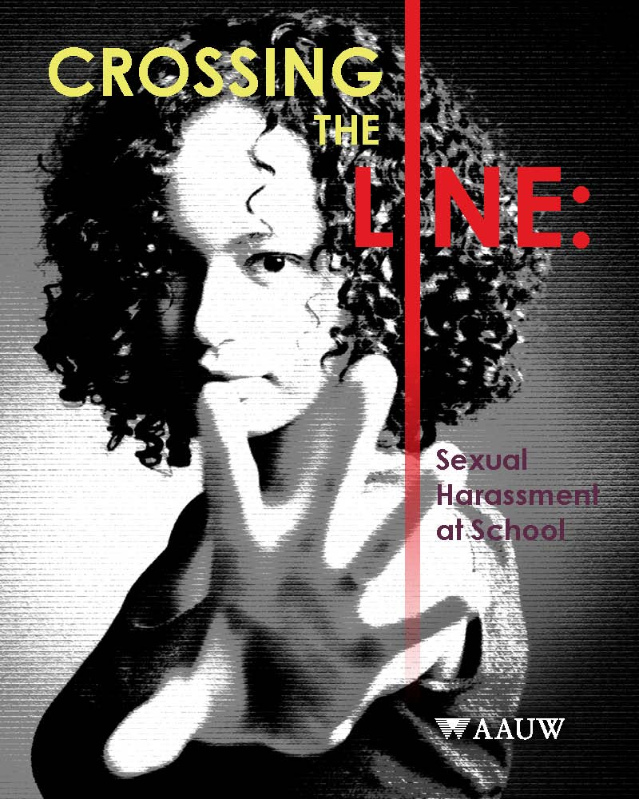
Crossing the Line: Sexual Harassment at School
To download the report, go to
www.aauw.org.
To contact the researchers, send an e-mail to
aauw-research@aauw.org.
Notes:
Sexual harassment is a widespread problem in middle and high schools. Sexually harassed students reported having trouble studying, not wanting to go to school, and feeling sick to their stomach. Some students stayed home from school. Sexual harassment led others to skip classes, drop activities, or even change schools. Girls were especially negatively affected because they faced a higher rate of sexual harassment than boys did, including the most physical forms of sexual harassment.
By undertaking the recommendations from the report and exploring promising local practices, all individuals concerned with creating a harassment-free school climate can collaboratively achieve a more equitable learning environment for all students.
As with every AAUW research reports, this report can make a difference only if people read it. Please help spread the word.
Please share these findings with
Teachers
School administrators
Parents
Students
Guidance counselors
PTAs
After-school groups
and others
The report can be downloaded for free from our website; the address is shown here.
You can also contact our research department at the e-mail address shown here if you have questions or comments.
Thank you so much.
[Indicate that you would be happy to take questions at this point if the event allows.]

