Slide 1
Financial Literacy
Presented By:
Sindy Polubothu
Irene Huang

Slide 2
Agenda
Student Loans
Budgeting
Salary Negotiation

Slide 3
What are Student Loans?
A student loan is designed to help students pay for cost of attending university
It may differ from other types of loans in that
interest rate may be substantially lower
repayment schedule may be deferred while the student is still in school
Student Loans
Budgeting
Salary Negotiation

Slide 4
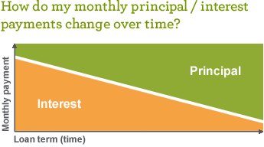
What are Student Loans?
More principal you pay,
the smaller the interest
Interest is % of total loan amount
Compounds over the years
Interest Rate
x Current principal balance
÷ Number of days in the year = Daily Interest
$10,000 student loan with 6% interest
Daily Interest: $10,000 * .06 / 365 days = $1.64 per day
Monthly Interest: $1.64 * 30 days = $49.28 per month
Student Loans
Budgeting
Salary Negotiation

Slide 5
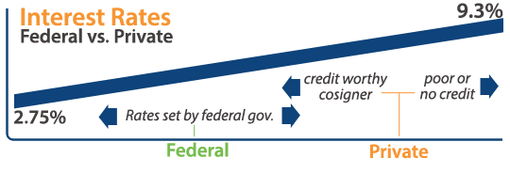
Different Types of Student Loans
Federal loans are available for both students and parents
No credit check required
Uniform low rates and requirements
Private student loans are borrowed from lending agencies
Credit requirements
Higher interest rates
Repayment schedules set by the lenders
Student Loans
Budgeting
Salary Negotiation

Slide 6
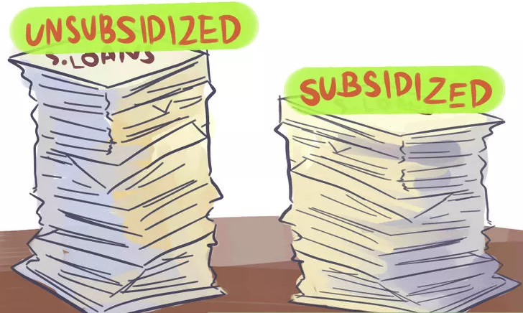
Federal Student Loans
Direct-Unsubsidized:
Not based on financial need available for both grad and undergrad students
Interest accumulates as soon as funds are disbursed
Higher rate for grad students
Direct-Subsidized:
Only for undergraduates based on financial need
Federal government pays interest while you are in school
Student Loans
Budgeting
Salary Negotiation

Slide 7
Federal Student Loans
Federal Perkins Loans:
Grads and undergrads with exceptional financial need
Fixed rate of approximately 5%
The school is the lender; payments go to the school, or the school's loan servicer
Student Loans
Budgeting
Salary Negotiation

Slide 8
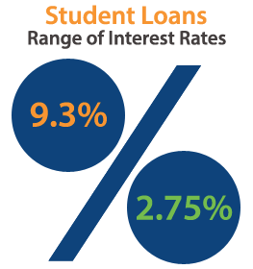
Private Student Loans
With a private bank or other private third party lender
Terms/conditions depend on agreement with lender
Generally higher interest rates
Accumulates interest as soon as funds are disbursed (while one is still in school)
May need co-signer
Harder to find low fixed rates
Student Loans
Budgeting
Salary Negotiation

Slide 9
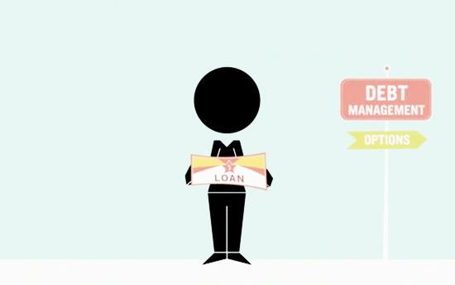
Tips on Loan Repayments
Still in School/Almost Graduation:
Manage your credentials (usernames/passwords) for loans websites
Consolidate all of your loans/rates/amounts on spreadsheet
Confirm when your loans accrue interest
Consider setting up direct deposit so you do not miss payments
Post Graduation/Long-Term Strategy:
Consider growth of interest on principal when you decide payment plan
Consider your timeline for repayment (account for potential life events)
Consolidate/refinance loans and search for lower rates
Consider setting up direct deposit so you will not miss payments
Student Loans
Budgeting
Salary Negotiation

Slide 10
What is Budgeting?
Some sort of plan for your future income and expenditures that you can use as a guideline for spending and saving
Student Loans
Budgeting
Salary Negotiation

Slide 11
Tips for Budgeting
Set of a % of income you want to save every month:
Think of future costs (mortgage, retirement, wedding, kids etc. )
Average Cost of
Raising a Child:
$241,080
Student Loans
Budgeting
Salary Negotiation

Slide 12
Tips for Budgeting
Consider a budgeting app:
Links your bank accounts
Set your spending limits
View your actual spending habits in categories compared to your budget
Student Loans
Budgeting
Salary Negotiation

Slide 13
Salary Negotiation
Some studies have shown that negotiating a few-thousand dollars more can add up to one million more in total earnings over the course of your career
Student Loans
Budgeting
Salary Negotiation

Slide 14
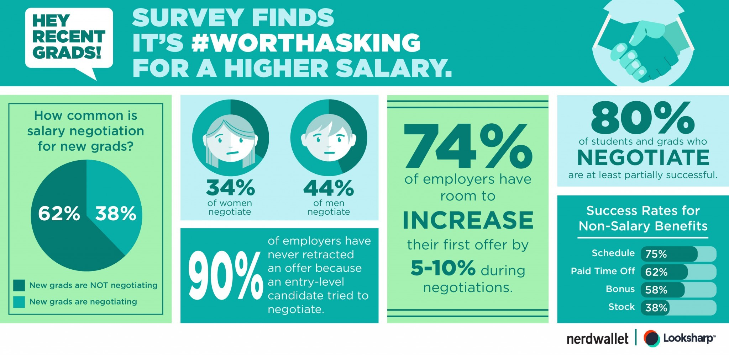
Salary Negotiation
Student Loans
Budgeting
Salary Negotiation
Notes:
https://www.nerdwallet.com/blog/loans/student-loans/negotiating-salary-study/

Slide 15
Before Accepting a Offer
Understand of your value:
know a typical salary & benefits range
consider the role, industry, city/location
Develop a thoughtful strategy:
be prepared to explain what you want
why you want it
how it will benefit the company
Have confidence!
Student Loans
Budgeting
Salary Negotiation

Slide 16
During the negotiation
Don’t ask because you want it. Ask because you deserve it.
Utilize your research
Is it comparable to current market value of that role?
Ask open-ended questions
Why wont they budge if they decline your initial counteroffer?
Ask for additional bonus as way of compensation
Look into the future
Make sure that you ask to revisit the compensation talk at a later date
Negotiating your first job offer will make you a more attractive candidate. Employers will recognize that you know your worth, and you’ll have set a respectful, self-assured tone for your time at the company.
Student Loans
Budgeting
Salary Negotiation
Notes:
https://www.nerdwallet.com/blog/loans/student-loans/what-to-say-negotiating-first-job/

Slide 17
When you shouldn’t negotiate
You Already Accepted
Don’t be too quick to accept, you cant ask once you already accepted the initial offer
2. They Tell You This Is Their Best Offer
Hiring managers and recruiters typically don’t spell it out so directly if there really is wiggle room in the offer
3. You Simply Have No Justification
The salary being offered is right in line with your industry, experience, and geography
Student Loans
Budgeting
Salary Negotiation
Notes:
https://www.themuse.com/advice/4-times-to-negotiate-your-salary-and-3-times-not-to

Slide 18
YWTF NYC
Younger Women's Task Force of New York City, is an empowered and inclusive community network that advocates for gender equality within the 5 boroughs and beyond

Slide 19
Thank You
Questions?

