Slide 1


Slide 2













My Sister’s Keeper
“MSK 2.0”
AAUW NYS
2011 - 2012

Slide 3
I am my sister’s keeper.
We are in this together.
Not to win
Not to compete
Not to conquer
But to educate
To nurture
To help.
We are each other’s keeper.
Let us celebrate
The power within us all
To make the difference
To change the world!
Dr. Natasha Josefowitz
Notes:
3

Slide 4





www.halftheskymovement.org/get-involved
Help her live. Help her learn. Help her earn.

Slide 5
My Sister’s Keeper
1.0
*LEARN MORE
*CONNECT MORE
*DO MORE
Notes:
5

Slide 6



The Issues
Violence Against Woman
Gendercide – Gynocide - Femicide/Human Trafficking
2. Education
3. Maternal Health Care & Reproductive Rights
4. Economic Empowerment
5. Women’s Rights & Gender Equality
Notes:
Gendercide – more girls have been killed in the last 50 years because they were girls, than men in all the wars in the 20th c.
Slavery –
Education – The Girl Effect
Maternal Health Care – somewhere in the world, a woman dies in childbirth every minute.
Economic Empowerment – China’s meteoric rise was due to women’s economic empowerment – 6 out 10 richest self-made women are Chinese.
Women’s Rights & Gender Equality
6 million children die of hunger every year according to CARE.

Slide 7
My Sister’s Keeper
2.0
*TAKING IT TO THE
NEXT LEVEL
*ASKING THE TOUGH
QUESTIONS
Notes:
7

Slide 8
Taking It to the Next Level.
Utilize past learning, encourage new alliances
within AAUW and your community, then
ask the tough questions:
Who really benefits from this project/work?
Is it sustainable, will it endure beyond the initial step?
What other organizations/NGOs are doing this work?
What can I/we do?
How can “fair trade” become part of my lifestyle?
Notes:
EGO Project
8

Slide 9
GETTING STARTED
Branch wide viewing and discussion of one of three films: Favela Rising, The Shape of Water, or The New Recruits.
Each film will encourage discussion and entice current and new members to develop or strengthen programming that will make AAUW NYS a beacon for women’s rights, education and equality.
Notes:
9

Slide 10




Slide 11
Problems & Solutions
1)Violence Against Women – Lawyers without Borders www.lawyerswithoutborders.org
2)Education – Project Have Hope www.projecthavehope.org
3)Maternal Health - BRAC www.brac.net
4)Economic Empowerment – Fair Trade
www.fairtraderesource.org
5)Human Rights – ATM Card/National ID Card
www.swwb.org
Notes:
11

Slide 12
MSK 2.0
See the movie and host a discussion with possible coalition partners
Be inspired to act, plan a program
Involve other AAUW branches, districts
Utilize state and national AAUW
Forge alliances with other “like – mission” groups
Notes:
12

Slide 13
Intra-Branch Coalitions
  Interest Groups
  Active Artists
  Art Interest
  Bridge
  Current Issues
  Financial Group
  Gourmet/Lunch
  Literature
  Networking
  Mahjong
  Walking Group
Action Groups
Community Service
Equity in Education
Public Policy
Tech Savvy Girls
Notes:
13

Slide 14
Community Coalition Partners
Women’s Groups
My Sister’s Place
Girl Scouts
Schools/Local Colleges
Individuals
Service Groups
Local Agencies
Local/International Organizations
Notes:
14

Slide 15
AAUW NYS MSK 2.0
Focus On…
Support a woman's business
Keep a girl in school
Eradicate obstetric fistula
Make girls smarter
Notes:
15

Slide 16
MSK Focus On…
Fistula
Fair Trade
Chocolate/Coffee
Women’s Banking
Water
Trafficking
Child Soldiers
Uganda
Guatemala
Literacy
Human Rights
CEDAW
Salt
HIV/AIDS
Notes:
16

Slide 17
Putting the FUN-draising!
Raffle – Baskets
Book/CD Sale
Wine & Cheese
Chocolate Tasting
Add 1$ to…
Small Change/Big Change
Fashion Forward
Dining for Women
Card/Game Night
Cocktail Party
Bowling for $$$
Flea Market
Tag Sale
Host a Dance/Gala
Luncheon/Tea
Notes:
17

Slide 18
AAUW NYS
MSK 2.0
RAISING THE NEXT
GENERATION
Notes:
18

Slide 19


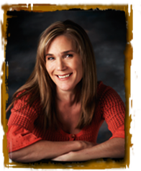

www.thetroublewiththealphabet.com

Slide 20
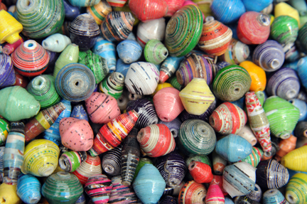
Working with Girl Scouts
*Choice
*Creativity
*Connections
*Collaborations
*Celebrations
Project Have Hope
Our educational program guide for teachers contains useful text, maps, and photos.
Feed a family.
Educate a child.
Empower a village.
Notes:
20

Slide 21
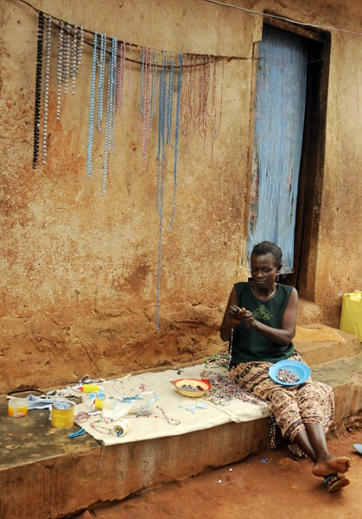
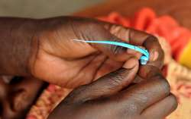
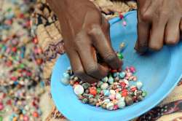
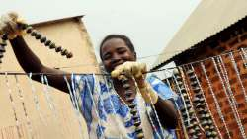
Project Have Hope www.projecthavehope.org

Slide 22

“for girls, by girls”
Girl Up, a campaign of the United Nations Foundation, gives American girls the opportunity to channel their energy and compassion to raise awareness and funds for programs of the United Nations that help some of the world’s hardest-to-reach adolescent girls.
Through Girl Up’s support, girls have the opportunity to become educated, healthy, safe, counted, and positioned to be the next generation of leaders.
www.girlup.org

Slide 23
Humanitarian Gift Guide
Nicholas Kristof – NY Times December 2010
Arzu (www.ArzuStudioHope.org)
First Book (www.firstbook.org)
Fonkoze (www.fonkoze.org
Partners in Health (www.pih.org)
Panzi Hospital (www.panzifoundation.org)
Campaign for Female Education (www.camfed.org)
Nurse Family Partnership (www.nursefamilypartnership.org)
Edna Hospital (www.ednahospital.org)
Somaly Mam Foundation (www.somaly.org)

Slide 24





How to Vet a Charity
American Institute of Philanthropy
www.charitywatch.org
Better Business Bureau Wise Giving Alliance
www.give.org
Charity Navigator
www.charitynavigator.org
Guide Star
www.guidestar.org
Give Well
www.givewell.org
Notes:
It is up to you to VET the organizations you select.
i.e. Kingston

Slide 25
AAUW NYS
MSK 2.0
AWARDS
APPLICATION
Notes:
25

Slide 26
AAUW NYS MSK Planning Guide
MSK Initiatives – Local/Global MSK 1.0 - 2010/11 MSK 2.0 – 2011/12
Violence against Women Gendercide/Human Trafficking
Education for Women and Girls
Economic Empowerment
Maternal Health
Human Rights/ Gender Equality

Slide 27
My Sister’s Keeper
Awards Application 2010-2012
1. Describe Year 1 of your branch’s MSK Project. What were your goals and outcomes? What was the level of branch participation? What partnerships were created? How did the greater community respond to your project? | 2. Describe Year 2 of your branch’s MSK Project. What were your goals and outcomes? What was the level of branch participation? What partnerships were created? How did the greater community respond to this project?
3. What did for Focus On in MSK 2.0? What have you learned from your MSK project? | 4. What is/was the impact on your branch and the larger community? Has MSK resulted in any sustainable programs or projects within your branch? What are your plans for MSK 3.0 in 2013?
Notes:
Please forward any flyers, programs as they happen.

Slide 28
“WIIFM”
What’s in it for me?
Learn & Grow
Enrich Your Life
Pride & Satisfaction
Good for your Family/Community/Country
Joy of a Shared Experience
Part of the Solution
“Living the Mission”
Lead by Example
Notes:
Become a GI
Get Inspired
Get Informed
Get Involved!

Slide 29
Become a GI!
Get Inspired
Get Informed
Get Involved
Notes:
29

Slide 30
Let us celebrate the power within us all to make a difference to change the world!

