Slide 1

ONE AAUW
ONE MISSION
ONE FUND
PROGRAMS AND INITIATIVES
THE AAUW FUND SUPPORTS
created by
Nancy Mion, NYS Development VP

Slide 2
CAMPUS ACTION PROJECTS
Programs based on AAUW Research to address gender-based issues in their campus community
Brockport students made a video to raise awareness to issues like the gender pay gap. They also held an anti stereotyping Start a Revolution conference
Purdue University STEM CAP Team -
Exploring Science with grade school girls

Slide 3
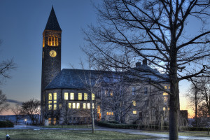
College/ University Partners
C/U membership opens doors to AAUW Programs
Student alfilate members and campus branches
Potential AAUW & branch members
Always throughout our history

Slide 4



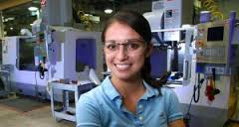

ELEANOR ROOSEVELT FUND
Supports research on gender equity in education and the workplace.

Slide 5
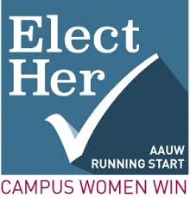
ELECT HER!
Encourages and trains college women to run for student government and future political office.
  Piloted in 2009; began fully in 2010
  SUNY Stony Brook- Smithtown Branch

Slide 6

EVVIE CURRIE GIVING CIRCLE
LAF CAMPUS OUTREACH GRANTS
Used to host events on campus educating students about their rights.
Grants of $750 per event
This Fund of $50,000 can
only be used by NYS members in NYS
Westchester Branch/SUNY Purchase

Slide 7
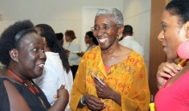
FELLOWS ALUMNAE INITIATIVE
Connects former AAUW fellows and grantees with one another and AAUW.
Former Fellow
Shireen Lewis

Slide 8

LEGAL ADVOCACY FUND (LAF)
LAF challenges sex discrimination in higher education and the workplace.
Started in 1981
Over 106 cases given over $2,000,000
The
monthly updates cases and actions
Know Your Rights at Work information

Slide 9
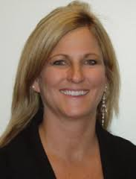
LAF Case Support Travel Grants
Pay the travel expenses of AAUW-supported plaintiffs and their lawyers who speak at state conventions
Recently we heard:
  Michelle Henley-Feather River
  Kathy Brenniman- LAF Committee Chair
  Lauren Mancuso- University of CA-Davis

Slide 10
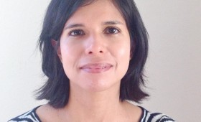

LAF LEGAL CASE SUPPORT
Adopts cases in the workplace and education that have the potential to protect all women.
Rizo v. Fresno County
Office of Education
Susan Burhans v Yale University
Moshak, Mason and Schlosser v.
University of Tennessee

Slide 11

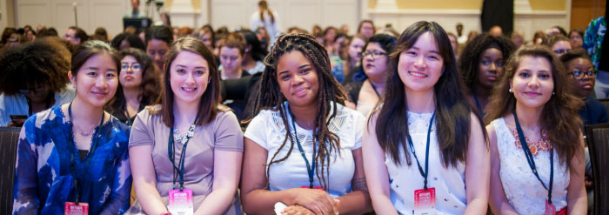
National Conference for College Women Student Leaders
Prepares attendees to be campus and community leader AAUW first hosted NCCWSL, 2002; AAUW acquired NCCWSL, 2016.

Slide 12

PUBLIC POLICY
Public Policy Program is approved by the Membership biennially.
AAUW members lobby on all levels
Weekly e-newsletter that highlights AAUW related issues and what action we can take
Two-Minute Activist makes it easy for members voices heard in Congress

Slide 13

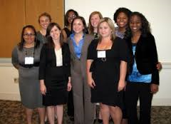
Students from campuses nationwide
  Advise AAUW staff about college students’ needs
  Lead on-campus gender equality projects
  Help plan NCCWSL
Founded 2002

Slide 14


Prepares college women to enter the job market with the confidence, knowledge, and skills they need to negotiate
salaries and benefits
Began in 2005
by the Wage Project;
acquired by AAUW in 2014.

Slide 15


One day hands on STEM Conference for 6-9th grade girls
Parents learn about STEM education and careers
Started by the Buffalo Branch in in 2006; Pilot program began nationally in 2016 with 22 sites

Slide 16

Weeklong STEM camps
Designed for Junior High girls
Purpose is to encourage involvement in STEM in high school, college, and beyond.
Great Video at https://youtu.be/ldHrqdn290M
Started in California in 1998 from an AAUW Community Action Grant; expanded nationally in 2012.

Slide 17

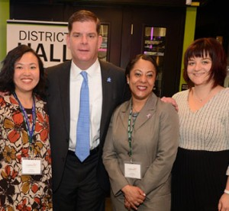
Working women learn how to evaluate, negotiate, and convey their worth confidently in the job market.
85,000 women in Boston will
participate in these workshops

Slide 18

This AAUW-affiliated entity is geared toward younger women fighting for social justice.
Launched in Jan 2005; AAUW acquired in 2013
There is a group in New York City

Slide 19


ADDITIONAL PROGRAMS
Funded in part by the AAUW Fund
AAUW National Convention
June 14-17 2017
Member Leader Programs
New Program Development
Outlook

Slide 20
WHY THE AAUW FUND
HISTORY-AAUW has used available money to funded worthwhile issues since 1885
NEW PROGRAMS developed in response to today’s challenges
EDUCATION-New programs reflect our abiding concern for women’s education with a 21st Century twist
NEED FOR FUNDS because: Dues do not cover Progam costs: Costs have risen but dues have not: Fewer branch members and more National members who cost more
AAUW FUND will provide unrestricted funds for today’s programs and those developed in the future

Slide 21
SUPPORT THE AAUW FUND
Greatest Opportunity
Greatest Need

Slide 22
SUPPORT THE AAUW FUND
Give your tax deductible contribution to your Branch AAUW Funds Chair
Make an online donation on the AAUW website www.aauw.org click on donate
Join the AAUW Legacy Circle

